Slide 1


Serve your Customers Using Power Virtual Agents
Aung Khaing
Solutions Architect | Datacom | Business Applications MVP

Slide 2


Aung Khaing
AK
Eat and breathe Apple
Reasonably experience
Infant MVP
Follow me
http://bit.ly/dynamicscode-blog
http://bit.ly/dynamicscode-github
http://bit.ly/dynamicscode-twitter
Connect me
http://bit.ly/dynamicscode-linkedin

Slide 3
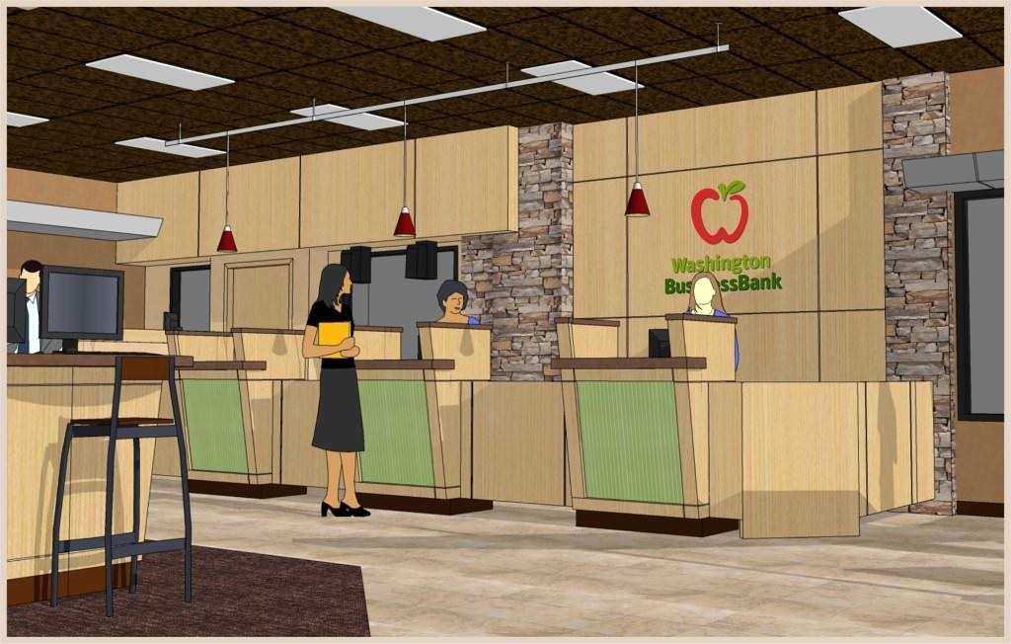
Evolution of customer service
Walk-in
Human interaction experience
High operation cost
Modernisation
Closing down branches
convenience
operation cost

Slide 4


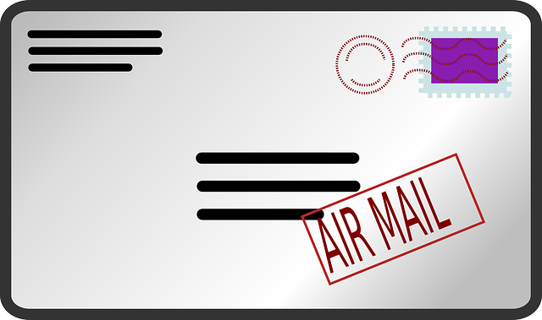


Evolution of customer service
Letter
Send and receive physical letters
Slow, unreliable
Threat from and to environments
Modernisation
Scan and save to SharePoint
Store records in Power Apps

Slide 5


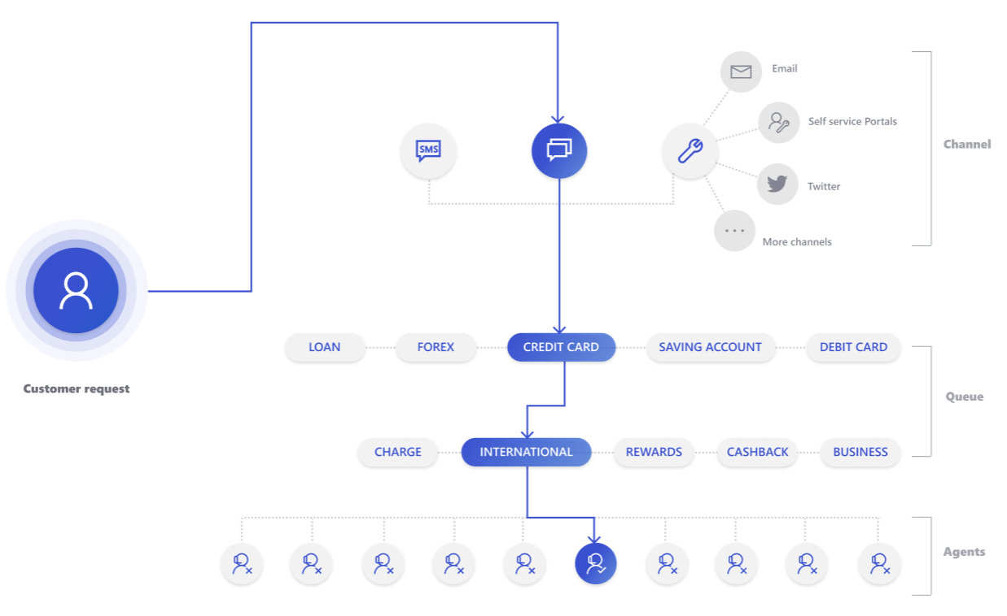
Evolution of customer service
Call centre
Relatively responsive
Human interaction experience
Expensive
resource and infrastructure
Modernisation
Record phone calls in Power Apps
Omni-channel and Channel Integration Framework

Slide 6



Evolution of customer service
Email
Relatively reliable, cheap and fast
Proof of record
Digital
No human interaction experience
Modernisation
Exchange integration in Power Apps
Easily track and link emails

Slide 7
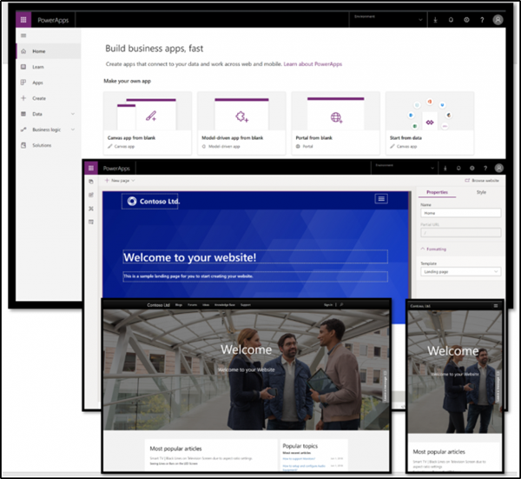
Evolution of customer service
Self-service portal
Fast and reliable
Success = Easy of use
No human interaction, not natural
High cost to build self-service
Modernisation
Self-service portal with Power Apps portal
Mobile apps

Slide 8




Evolution of customer service
Chatbot
Simulate human interaction
intelligence and natural language processing
Can be transferred to human agents
Low operation cost
Relatively complex to build a chatbot
Example
Siri, Alexa, Cortana

Slide 9
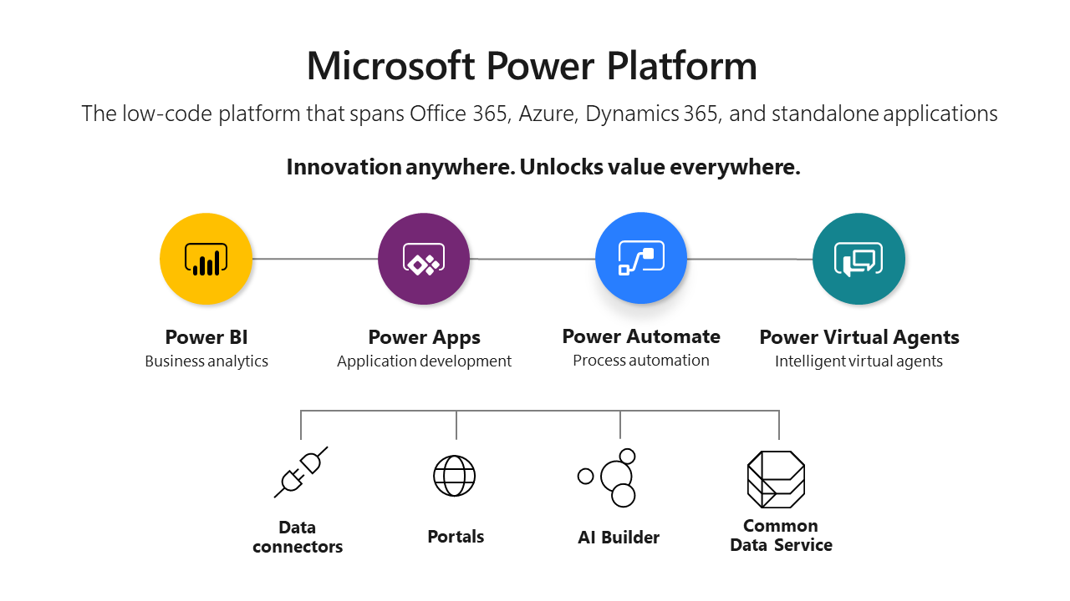
Power Virtual Agents

Slide 10


Customers’ expectation
All the best
Easy to build
12 years old can build
Allow extending
Professional developers and geeks
Simple pricing
Pay per session

Slide 11
PVA - Features
Built on Microsoft Bot Framework
Point and click
Components
Topics
Ask
Actions – Flow, Authentication, Skill
Response
Easy integration to client apps
Direct Line integration for advanced usage

Slide 12
PVA - Demo

Slide 13
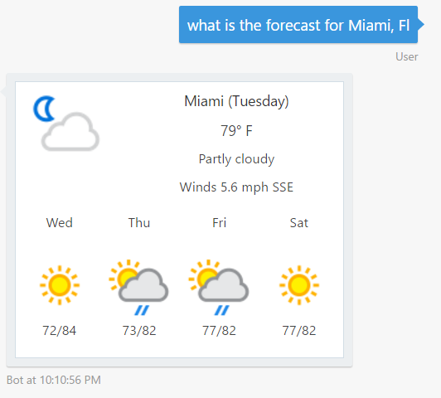
PVA – Upcoming features
Canvas app support
Customise bot to handle no topic
Part of solution
Pass context to bot from calling sites
Adaptive card
Single sign-on
Voice and phone call interactions

Slide 14
Resources
https://powervirtualagents.microsoft.com/en-us/blog/category/powervirtualagents/
https://docs.microsoft.com/en-us/power-virtual-agents/

Slide 15
Community Resources
https://poszytek.eu/en/microsoft-en/office-365-en/pva-en/pva-series-authentication-in-power-virtual-agent/
https://www.youtube.com/watch?v=25tncJEBb7M
https://dhina.org
https://www.linkedin.com/in/lisa-crosbie
https://www.linkedin.com/in/eelane
https://www.linkedin.com/in/jessicamilitar

Slide 16

Thank you

